Slide 1
Introduction to HPC and Parallel Computing
Training Module

Slide 2
Parallel computing Overview:
Parallel computing schemes (SISD, SIMD, MISD, MIMD).
Parallel programming models:
SMP/OpenMP
multi-threading
distributed memory
MPI
data-parallel and GPU
Evaluating performance of a parallel program (speedup, efficiency, scaling).
NOTE: This tutorial is designed to be interactive. We recommend using a shell on Discovery to execute the commands
Notes:
Parallel examples in C/C++ and Python.

Slide 3
Access the training material:
RC will provide a compressed file: HPC_training.zip at the beginning of the tutorial. Download this file to your local machine.
Copy the training material to your $HOME directory on Discovery. You can use one of these options:
Using the File Explorer on OOD: https://ood.discovery.neu.edu/ for more info: https://rc-docs.northeastern.edu/en/latest/using-ood/fileexplore.html
Using a terminal/shell (see instructions: https://rc-docs.northeastern.edu/en/latest/using-discovery/transferringdata.html?highlight=scp# )
Access a Discovery Linux shell/terminal (use one of the following options):
Terminal/shell app: https://rc-docs.northeastern.edu/en/latest/get_started/connect.html
OOD shell: https://ood.discovery.neu.edu/pun/sys/shell/ssh/ood.discovery.neu.edu
Notes:
Parallel examples in C/C++ and Python.

Slide 4
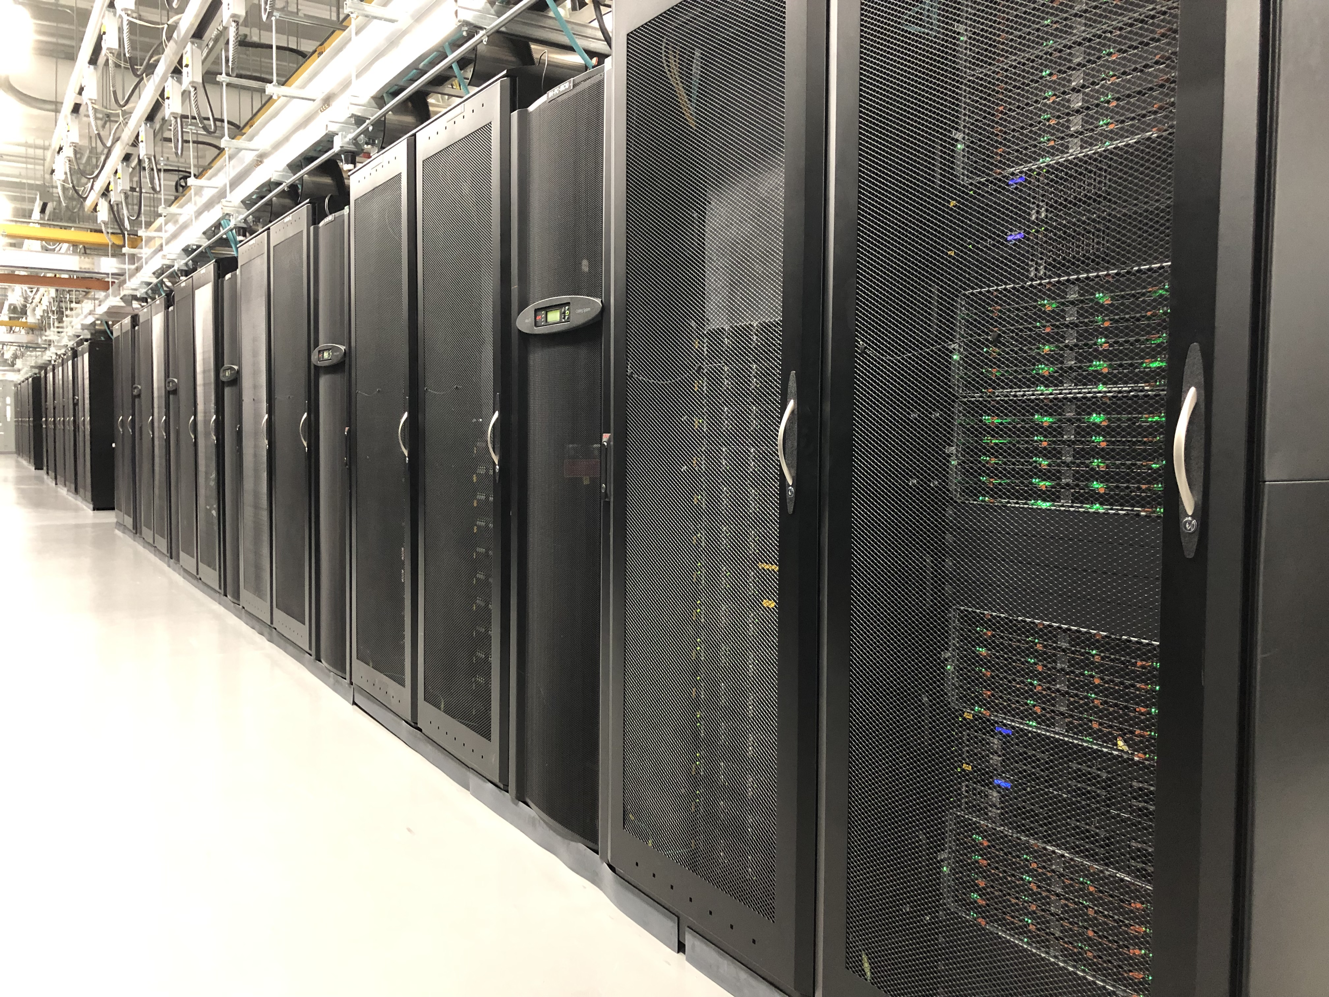
What is HPC?
Computing on a system (such as Discovery) with processing capacities at the frontline of contemporary abilities.
Typically, HPC systems are many powerful computers connected together via a computer network.
HPC relies on parallel computing technologies to achieve high performance.
Notes:
High Performance Computing (HPC) is performing computations on a so-called supercomputer, which is usually a system that is considered at the frontline of contemporary processing capacity. The processing capacity is mainly evaluated based on the processing speed and the memory capacity. Typically, this is achieved through connecting many powerful computers together into a computer cluster via a computer network, so that the many connected computers can be used as a single machine. The HPC system relies on parallel computing technology in order to process data extremely fast.
Discovery Cluster in the MGHPCC (Holyoke, MA)
24,000 CPU cores
over 200 GPUs
Connected to Northeastern via 10 Gbps Ethernet (GbE)
Active, archive, secure, and cloud storage solutions

Slide 5
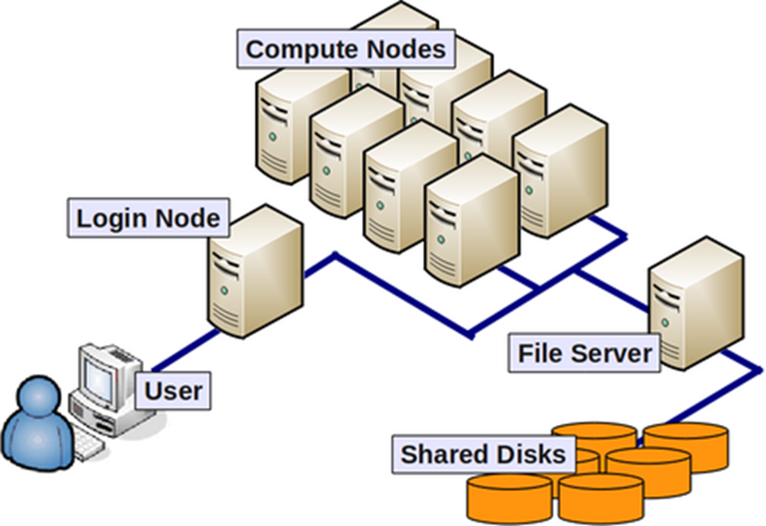
General terminology
Compute nodes: servers that perform HPC calculations.
Login nodes: servers for remote connection to the cluster.
Network: connect between nodes (LAN).
File system servers: manage cluster shared storage.
Scheduler: manages HPC resources between users.
Image from: https://wiki.rc.hms.harvard.edu/display/O2/O2+HPC+Cluster+and+Computing+Nodes+Hardware
Notes:
Compute node / Node - a standalone computer/server/worker node in the cluster, which is running its own instance of the operating system (typically, Linux-OS like CentOS) and is interconnected with the other nodes via a network. Usually has multiple CPUs/processors/cores a separate memory, network interfaces, etc.
CPU / Socket / Processor / Core - may vary upon context and manufacturer. Initially, a CPU (Central Processing Unit) was referred to a single component within a computer. When multiple CPUs were introduced, each CPU was subdivided into multiple "cores", which were considered single processing units. Sockets are referred to as CPUs with multiple cores, though this term can depend on the vendor.
Task - A logical section of a computational workflow, typically a program or a set of instructions that is executed by a parallel unit. A parallel program consists of multiple tasks executed simultaneously.
Network - different nodes in the cluster are usually connected to each other through fast local area networks (LAN). Faster connections like InfiniBand (IB) connection provide high throughput and low latency.
Partition - (on the Discovery cluster) are groups of nodes that are grouped into logical sets.
Clock cycle - the speed unit of a CPU and corresponds to the electronic pulse of a CPU, during which the CPU performs a basic operation.

Slide 6
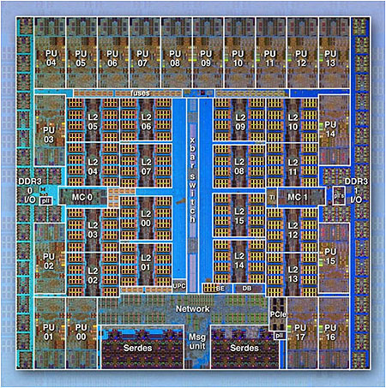
General terminology
IBM BG/Q Compute Chip with 18 cores (PU) and 16 L2 Cache units (L2)
Processor/CPU/Core: Central Processing Unit – a single processing component within a computer.
Socket: CPUs with multiple cores (terms depends on vendor).
Task: A logical section of a computational workflow executed by a parallel unit.
Parallel Program: consists of many tasks that can be executed in parallel.
Clock Cycle: CPU speed unit for a single basic operation.
Image from the Lawrence Livermore National Laboratory Computing: https://computing.llnl.gov/
Notes:
Compute node / Node - a standalone computer/server/worker node in the cluster, which is running its own instance of the operating system (typically, Linux-OS like CentOS) and is interconnected with the other nodes via a network. Usually has multiple CPUs/processors/cores a separate memory, network interfaces, etc.
CPU / Socket / Processor / Core - may vary upon context and manufacturer. Initially, a CPU (Central Processing Unit) was referred to a single component within a computer. When multiple CPUs were introduced, each CPU was subdivided into multiple "cores", which were considered single processing units. Sockets are referred to as CPUs with multiple cores, though this term can depend on the vendor.
Task - A logical section of a computational workflow, typically a program or a set of instructions that is executed by a parallel unit. A parallel program consists of multiple tasks executed simultaneously.
Network - different nodes in the cluster are usually connected to each other through fast local area networks (LAN). Faster connections like InfiniBand (IB) connection provide high throughput and low latency.
Partition - (on the Discovery cluster) are groups of nodes that are grouped into logical sets.
Clock cycle - the speed unit of a CPU and corresponds to the electronic pulse of a CPU, during which the CPU performs a basic operation.

Slide 7
Parallel Computing Architectures

Slide 8
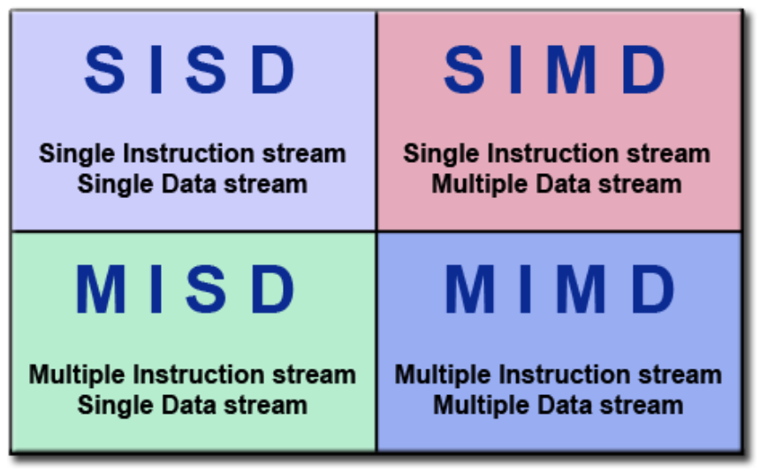
Parallel computing architecture models
Flynn’s Classical Taxonomy:
A parallel computing classification model that distinguishes architectures based on two parameters:
Instruction stream
Data stream
Where each can be single or multiple.
Image from the Lawrence Livermore National Laboratory Computing: https://computing.llnl.gov/
Notes:
One widely used classification model for parallel computing is "Flynn's Classical Taxonomy", which distinguishes computer architectures based on two parameters: Instruction Stream and Data Stream, where each can be either single or multiple. These models are fairly abstract so we'll use a "processing unit" which may refer to either a core, a CPU, a processor, a computer or a set of computers.

Slide 9
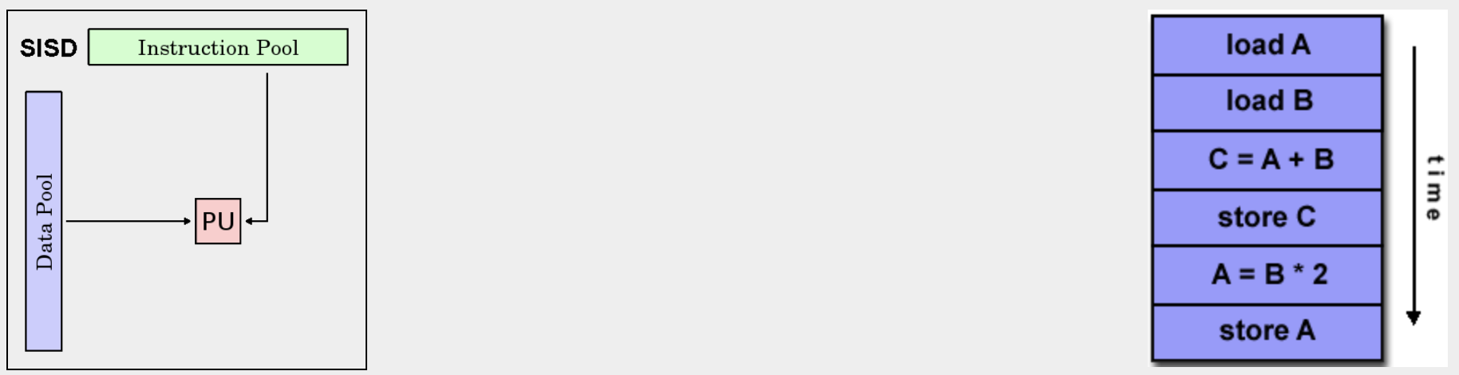
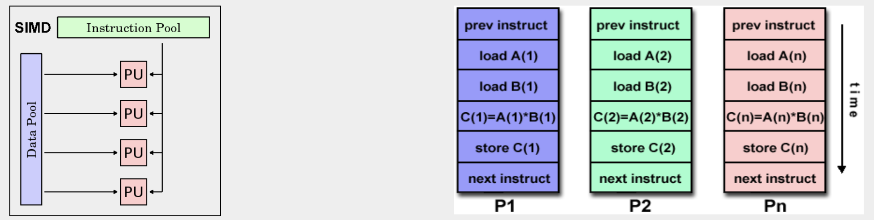
SISD & SIMD
Single Instruction, Single Data (SISD): a single processing unit performs a single instruction on a single data stream during one clock cycle.
Single Instruction, Multiple Data (SIMD): a single instruction is executed by multiple processing units on different data elements at any given clock cycle.
Images from the Lawrence Livermore National Laboratory Computing: https://computing.llnl.gov/
Notes:
Single Instruction, Single Data (SISD) - non-parallel architecture where a single processing unit performs a single instruction on a single data stream during one clock cycle.
Single Instruction, Multiple Data (SIMD) - a type of parallel architecture, where a single instruction is executed by multiple processing units on different data elements at any given clock cycle. Suitable for types of problems such as graphics and image processing, and employed by graphics processor units (GPUs).

Slide 10
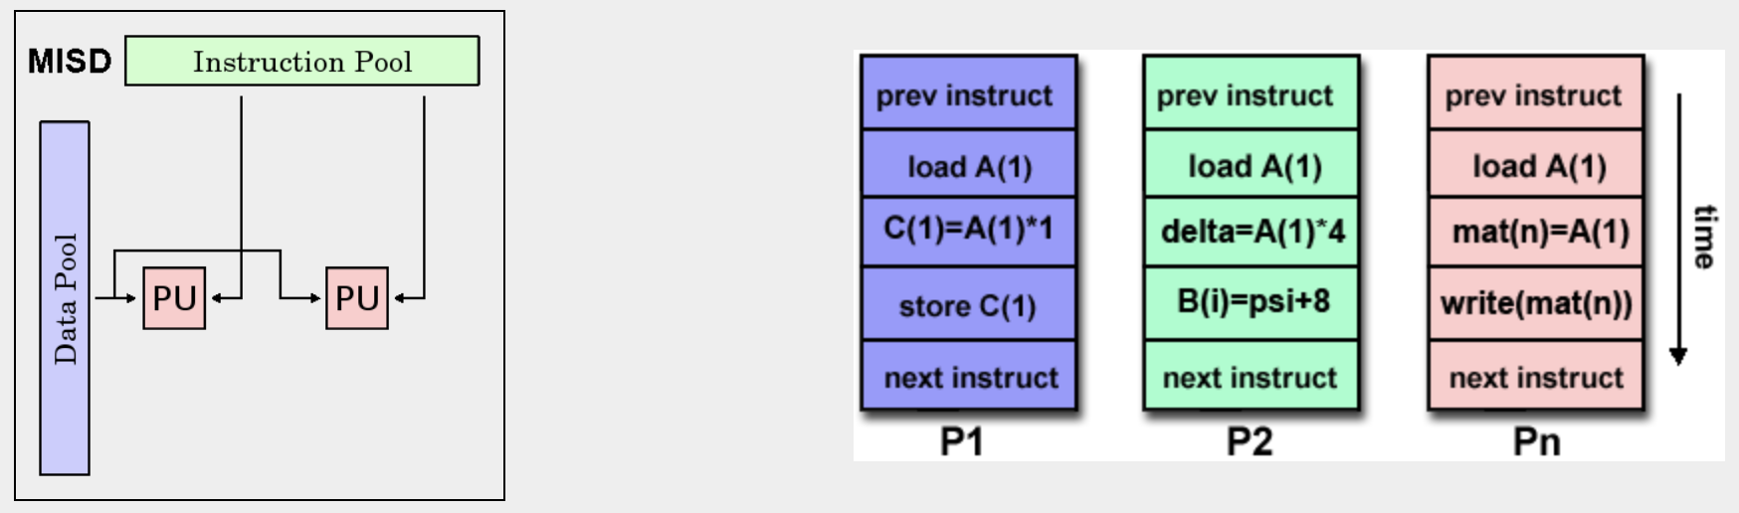
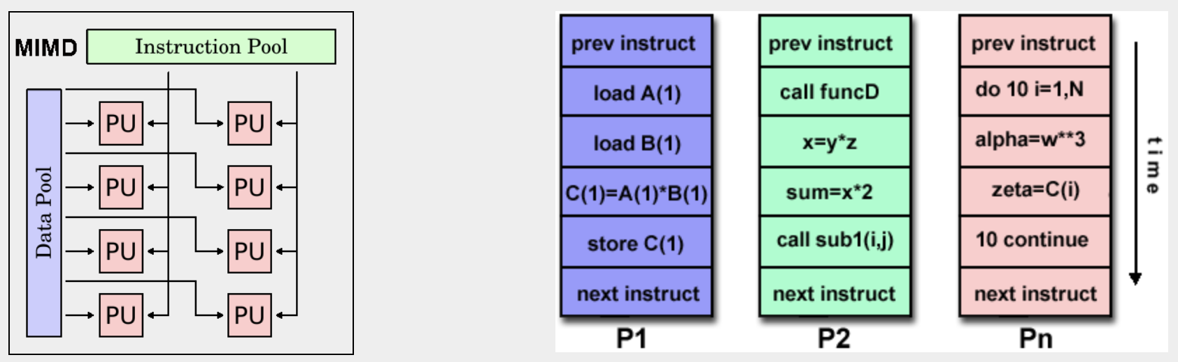
MISD & MIMD
Multiple Instruction, Single Data (MISD): each processing unit operates a different multi-instruction stream on the same data (least common).
Multiple Instruction, Multiple Data (MIMD): every processing unit may execute a different instruction with a different data stream (most common).
Images from the Lawrence Livermore National Laboratory Computing: https://computing.llnl.gov/
Notes:
Multiple Instruction, Single Data (MISD) - a type of parallel architecture, where each processing unit operates a different multi-instruction stream on the same data. This is the least common class of parallel architectures and few (if any) were implemented.
Multiple Instruction, Multiple Data (MIMD) - the most common type of a parallel architecture, where every processing unit may execute a different instruction with a different data stream. Most modern supercomputers fall into this category as well as networked parallel computers and "grids", multi-processor SMP computers and multi-core PCs. Note that this category often contains SIMD sub-components.

Slide 11
Parallel Memory Architectures

Slide 12
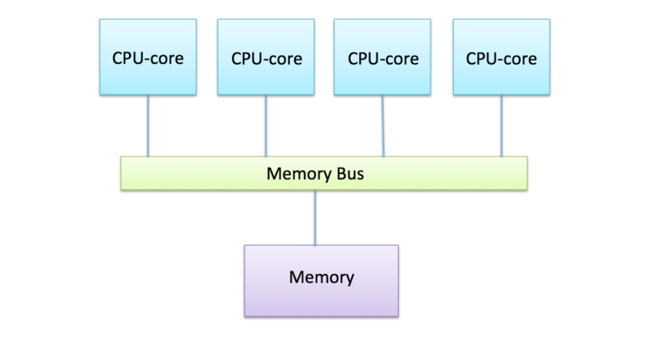
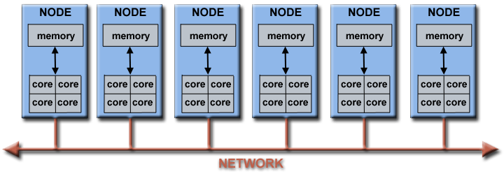
Parallel memory
Shared memory
Shared memory: all processing units to access it as a global address space.
Distributed memory: each processing unit has local memory (cache) that is not visible to other processors.
Hybrid (distributed+shared): is the most common in HPC:
Inside the node – shared memory
Between nodes – distributed memory
Distributed/Hybrid memory
Images from: https://www.futurelearn.com/courses/supercomputing/0/steps/24017
Lawrence Livermore National Laboratory Computing: https://computing.llnl.gov/
Notes:
Shared memory architectures - are characterized by the ability of all processing units to access it as a global address space. Cache coherency is maintained in a shared memory environment. The two main classifications:
Uniform Memory Access (UMA) - represented by Symmetric Multiprocessor (SMP) machines, with identical processors and equal access times.
Non-Uniform Memory Access (NUMA) - often made by linking several SMP machines, resulting in different accessing times to different memory elements.
Distributed memory architectures - each processing unit has its own local memory on which it operates independently. Changes made in a processor's local memory are not visible to other processors, hence access of data and communication between processors requires the explicit interpretation by the programmer.
Hybrid distributed-shared memory - the most common memory architecture for HPC, where both shared and distributed memory is employed. Shared memory components may be a shared memory node or GPUs and the distributed component is the networking between different machines.

Slide 13
Parallel Programming Models

Slide 14
Parallel programming models
Parallel Programs Layer
Program 1
Program 2
Process 1
Process 2
Process 1
Process 2
Task 1
Task 1
Task 1
Task 1
Parallel programming models use the parallel architectures.
Are an abstraction above hardware and are not specific to any hardware type.
Comes in the form of process or task that can communicate and access data in a unique way.
The chosen model should depend on the problem to be addressed.
Task 2
Task 2
Task 2
Task 2
Operating System
Hardware Layer
Cluster Network
Node 1
Node 2
CPU1
CPU2
CPU1
CPU2
Shared memory
Shared memory
Image: Northeastern RC.
Notes:
The parallel programming models exist as an abstraction above the hardware and memory architectures.
They are not specific to particular machine or memory types, and can be implemented in various architectures.
The parallel abstraction comes in the form of a process or task that can communicate and access data in a unique way. Note: There is no "better" model and the best one to apply will depend on the type of problem to be addressed.

Slide 15
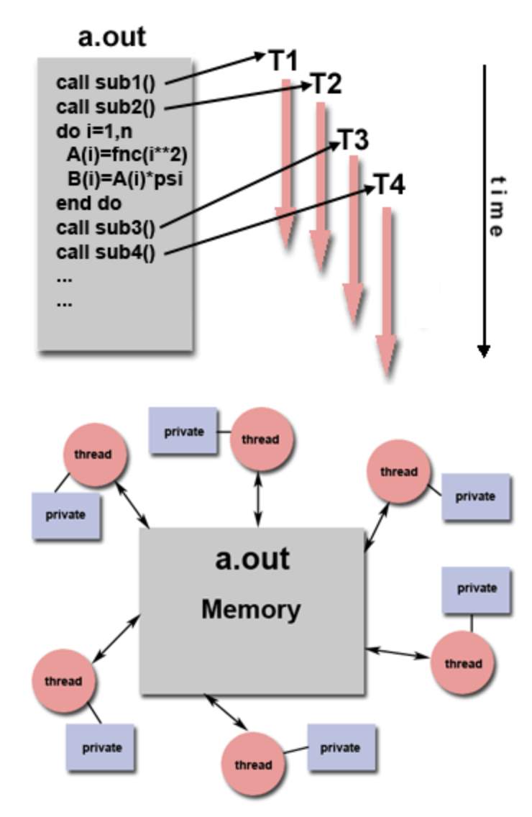
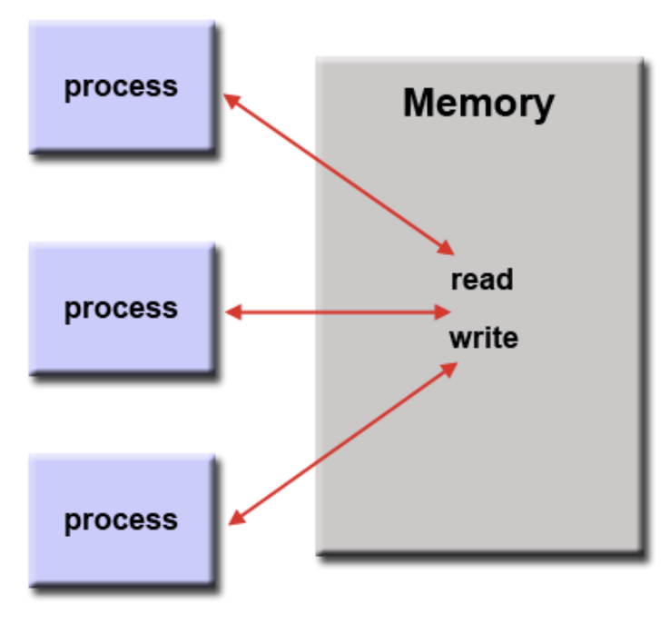
Shared memory models
Multi-thread model
No thread model
Shared memory (without threads): processes share the same resources in an asynchronous manner.
Multi-thread models: master process controls many ”light-weight” threads:
Requires more control by the programmer.
Threads of the same process access the same resources.
Some implementations: POSIX threads, OpenMP, CUDA threads.
Images from the Lawrence Livermore National Laboratory Computing: https://computing.llnl.gov/
Notes:
The most common models used are:
Shared memory (without threads) model - processes/tasks share the same single memory area and share resources in an asynchronous manner. This is the simplest parallel model as it does not require the programmer to clarify the communication between processes/tasks. This is mainly used for stand-alone shared memory machines. For example, the POSIX standard provides an API for using shared memory.
Multi-thread model - In this model, a single "master" process controls many "light weight" threads. This is also a shared memory model with more control by the programmer. The threads of a single process can access the same memory, but not allowed to access the memory of other processes. There are several implementation standards of threads:
POXIS Threads / Pthreads - part of the Unix/Linux operating system (OS). Very explicit parallelism; requires significant programmer attention to detail.
Note:
There are other thread-based implementations that are commonly used but are not covered in this tutorial. These include Microsoft threads, Java and Python threads and CUDA threads for GPUs.

Slide 16
Exercise 1 Shared Memory Parallelization using OpenMP

Slide 17
Exercise 1 Shared memory parallelization using OpenMP
Goals:
Run a C++ vector multiplication code in parallel using multiple threads that share memory.
Estimate code performance given different core counts.
Motivation:
Learn to run an efficient OpenMP-enabled parallel program on Discovery.
Why OpenMP?
OpenMP is an industry standard for threading.
OpenMP shared-memory communication works within a single machine/node.
Notes:
OpenMP - stands for Open Multi-Processing and the industry standard for threading. It is used in many of the hardware and software vendors, organizations and individuals. It is compiler directive based, portable, multi-platform OS. Available in C/C++ and Fortran implementations and very easy to use. OpenMP principles:
Uses the fork-join method for parallel execution - all programs being with a single master thread that runs in serial until the parallel regions are reached. The master then "forks" parallel threads within the parallel region and "joins" the threads after they are all complete to execute their part.
Most data within the parallel region is shared, unless specified otherwise by the programmer.
OpenMP has no I/O specifications so be careful when reading/writing to the same file.
Exercise description:
In this exercise, we will run a C++ code with OpenMP parallelization. The motivation to use OpenMP in HPC applications is that it is often the preferred method to parallelization on a single node. OpenMP is generally limited to a single node, but is highly efficient when combined with MPI (discussed later) to allow for full scalability on the cluster.

Slide 18
Exercise 1 Task 1: code compilation
OpenMP in C++ code:
To use OpenMP library in C++, we added line:
Parallel code segments start with the following statement:
The GNU (g++) compiler supports OpenMP and can be used to compile C++ with OpenMP.
#include <omp.h>
The C++ code vecMult.cpp calculates vector multiplication of two arrays.
Enter directory Exercise_1 and inspect the C++ script vecMult.cpp:
identify the parallel code segment.
Load the gcc/8.1.0 compiler module and compile the C++ code into an executable program multiVec:
#pragma omp parallel for
$ cd Exercise_1
$ cat vecMult.cpp
OpenMP principles:
Uses the “fork-join” method: a single master process forks multiple threads at parallel parts of the code, then joins them.
Most data is shared, but can be further controlled by programmer.
No I/O synchronization.
$ module load gcc/8.1.0
$ g++ -o multVec -Wall -Wextra -pedantic -fopenmp vecMult.cpp
Notes:
The C++ code "vecMult.cpp" will perform vector multiplication in parallel of two random arrays. The code will perform multiple times and execution times will be printed.
Step 1 - Go to (cd to) the directory "Exercise_1" and look at (cat) the C++ code "vecMult.cpp". Note that for C/C++ you need to include the #include <omp.h> header file. The syntax: #pragma omp parallel default(shared) private(x,y) indicates that an OpenMP parallel directive is coming. This usually comes before any loops.

Slide 19
Exercise 1 Task 2: SLURM parallel job
SLURM multi-core allocation options:
The Discovery scheduler system SLURM allows users to allocate multiple cores using different SLURM flags:
-N/--nodes=X: allocates X nodes.
-n/--ntasks=Y: allocates one processor per task (Y CPUs total).
-c/--cpus-per-task=Z: allocates Z CPUs per task (default: 1 CPU per task). One thread per core allowed.
For the full list of options:
https://slurm.schedmd.com/sbatch.html
Familiarize the parallel runtime shell environment within the SLURM job: submit.bash
Identify the SLURM resource allocation parts - how many cores? how many nodes requested?
Where is the total number of OpenMP threads defined? threads:
Interpret the meaning of this shell command:
Submit the job:
export OMP_NUM_THREADS=16
./multVec $nOMPThreads &> OMPperformance.$nOMPThreads.log
Note – the jobs in this tutorial are meant to run on the “HPC-training” reservation.
$ sbatch submit.bash
Notes:
Export the OpenMP environment variable OMP_NUM_THREADS to the desired number of threads and run multVec with the same amount of threads.
We will run our binary on 1,2,4,8,16 threads and calculate the performance. Execute the following in your command line: sbatch submit.bash.

Slide 20
Exercise 1 Task 3: Calculate basic performance
Check if the job completes by typing:
Once completed, inspect output files. The file performance.all includes the runtime averages for each core count.
Analyze the runtime performance by running the Python script in the given notebook: calc_performance.ipynb. You can open the file using the OOD Jupyter notebook app: https://ood.discovery.neu.edu/pun/sys/dashboard/batch_connect/sys/jupyter/session_contexts/new
The script will produce a plot of runtime vs. number of cores/threads. What is the optimal number of cores/threads to use?
$ sacct –S now –u $USER
Notes:
You should get an output file: performance.all that summerizes the average runtime of the parallel function for different numbers of OpenMP threads.
Analyze the performance by running the Python script in the next cell on the performance.all file. Review the "Evaluating performance of a parallel program" section for more details.

Slide 21
Parallel Programming Models (Cont.)

Slide 22
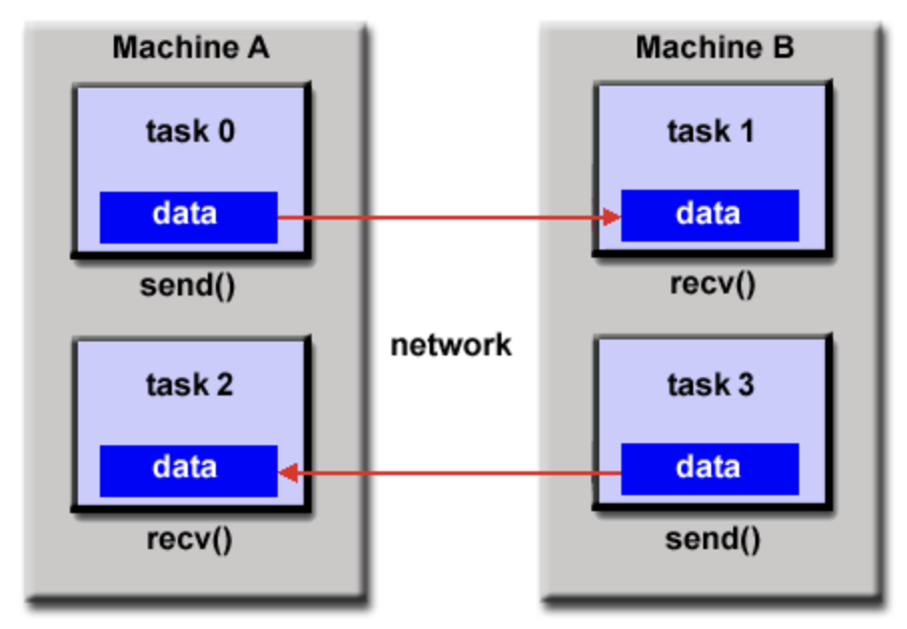
Distributed memory - message passing model
The problem’s tasks use their own local memory.
Tasks can reside either in the same machine or multiple machines.
Exchange data through massage-passing protocols.
The Message Passing Interface (MPI) is the most well-known implementation of this model.
Images from the Lawrence Livermore National Laboratory Computing: https://computing.llnl.gov/
Notes:
Distributed memory / Message Passing model - in this model, the main problem is divided into separate tasks that use their own local memory during computation. The tasks can reside either on the same machine or on multiple machines. They exchange data through message passing protocols. Data transfer is usually cooperative. The most well known implementation of this model is the Message Passing Interface (MPI) (All MPI specifications are available on the web at http://www.mpi-forum.org/docs/).

Slide 23
MPI on Discovery
MPI
Though MPI has be standardized, there are many library implementations:
Open MPI:
MPICH:
MVAPICH2:
Intel MPI:
Discovery has multiple MPI modules to chose from.
You should always use MPI libraries suitable to the type of compiler you are using.
Most commonly used compilers:
Intel compilers:
GNU compilers:
$ module avail openmpi
$ module avail mpich
$ module avail mvapich2
$ module avail intel
$ module avail intel
$ module avail gcc
Note: MPI module names will include the compiler, unless compiled with the default GNU 4.8.5 OS compiler.
Notes:
MPI is the industry standard for message passing. It is practical, portable, efficient and flexible.
MPI interface specifications include C++ bindings, MPI-3 has FORTRAN support and mpi4py has an interface MPI for python.
Although the MPI interface has been standardized, actual library implementations vary. For example:
MVAPICH & Open MPI work on Linux OS and is built for the GNU, Intel, PGI and Clang compilers.
Intel MPI works on Linux OS and built for the Intel and GNU compilers.
IBM BG/Q MPI work on the BG/Q clusters and IBM and GNU compilers
Note: Our cluster contains multiple compiler types, most commonly used:
Intel compilers: intel/2019-4, intel/compilers-2020u2
GNU compilers: gcc/5.5.0 gcc/6.4.0 gcc/7.3.0 gcc/8.1.0, gcc/9.2.0 and gcc/10.1.0.
You should always use MPI libraries suitable to the type of compiler you are using. Discovery also has many different MPI implementations such as:
OpenMP MPI - module avail openmpi to see full list of options. Most modules will have the compiler listed in the module name, unless it was compiled with the default GNU 4.8.5 OS compiler. For example, typing module show openmpi/4.0.3-skylake-gcc7.3 will show the full details of the module - it was compiled using GNU 7.3.0 on the Skylake architecture (d-nodes) and supports Infiniband network.
MPICH MPI - module avail mpich to see the full list of options.
MVAPICH2 MPI - module avail mvapich to see the full list of options.
Intel MPI - module avail intel to see the full list of options (includes compilers too). MPI modules include: intel/mpi-2020u2 and intel_mpi/2018u5.
Our current module system does not implement restrictions on loading incompatible modules, so please be aware of potential bugs by doing that!

Slide 24
Exercise 2 Distributed Memory Parallelization using MPI

Slide 25
Exercise 2 Distributed memory parallelization using MPI
Goals:
Run parallel matrix operations in Python using multiple MPI processes in a distributed memory environment.
Estimate code performance given different core counts.
Motivation:
Learn to run an efficient MPI-enabled distributed parallel program on Discovery.
Why MPI?
MPI is a standard communication method across multiple nodes.
MPI is a portable, efficient, and flexible standard widely used in HPC.
Notes:
OpenMP - stands for Open Multi-Processing and the industry standard for threading. It is used in many of the hardware and software vendors, organizations and individuals. It is compiler directive based, portable, multi-platform OS. Available in C/C++ and Fortran implementations and very easy to use. OpenMP principles:
Uses the fork-join method for parallel execution - all programs being with a single master thread that runs in serial until the parallel regions are reached. The master then "forks" parallel threads within the parallel region and "joins" the threads after they are all complete to execute their part.
Most data within the parallel region is shared, unless specified otherwise by the programmer.
OpenMP has no I/O specifications so be careful when reading/writing to the same file.
Exercise description:
In this exercise, we will run a C++ code with OpenMP parallelization. The motivation to use OpenMP in HPC applications is that it is often the preferred method to parallelization on a single node. OpenMP is generally limited to a single node, but is highly efficient when combined with MPI (discussed later) to allow for full scalability on the cluster.

Slide 26
Exercise 2 Task 1: MPI-Python script
MPI concepts (Python objects):
Rank – the MPI process ID.
Communicator – connects groups of processes (Comm class).
Point-to-point communication – includes basic commands (send(),recv()).
Collective communication – involves communication between groups of processes (bcast(),scatter(),gather()).
Collective communicators will distribute/collect data evenly across all ranks.
Inspect script calcMatrix.py:
Identify the communicator initialization.
What type of communication scheme is being implemented?
Which pieces of code are executed by the master process? The other ranks?
$ cd Exercise_2
$ cat calcMatrix.py
Notes:
The Python module mpi4py is being used, which is based on MPI-2 C++ bindings. It supports almost all MPI calls and is popular in Linux clusters. It supports optimized communication of NumPy arrays. Here are the mpi4py features:
MPI_Init is called when mpi4py is imported, and MPI_Finalize is called when the script exits.
We used the default communicator named: MPI.COMM_WORLD, which is an object that provides the MPI communication environment.
We can retrieve information about the environment like the total number of MPI ranks (comm.Get_size()) or the current rank/ID of the process (comm.Get_rank()).
The master process is usually assigned with rank=0.
The basic communication operations are comm.send(obj,dest,tag) and comm.recv(source,tag,status) (not used in this script). "tag" can be used as a filter, "source" and "dest" can be used as any rank, and "status" gives information about the received message.
Most of the time, MPI is used for collective operations (1-to-many, many-to-1) as it is more convenient and efficient.
Scatter - comm.scatter(sendobj, root=0) will distribute an object contiguous sections across all ranks of a communicator.
Gather - comm.gather(sendobj, root=0) will gather all elements of the ranks to the single rank=0 process and create an assembled element out of all those values.
There are many more possible operations that are possible with mpi4py, you can learn more about it at: https://mpi4py.readthedocs.io/en/stable/.

Slide 27
Exercise 2 Task 2: Run the Python job
Inspect SLURM script main_py.bash:
The script loads the MPI and python environment by using a Discovery anaconda3 module.
The script runs MPI by invoking the mpirun command. The flag –n specifies the number of MPI ranks.
Submit the job:
$ cat Exercise_2/main_py.bash
$ sbatch main_py.bash
Note – the jobs in this tutorial are meant to run on the “HPC-training” reservation.
Notes:
Step 2 - The Slurm script main_py.bash will run the python script calcMatrix.py on 1,2,4,8,16 and 32 MPI processes. Note that there is no need to allocate all tasks on the same node, as shared memory is not required. The Slurm script loads the modules anaconda3/2019.10 to provide the MPI libraries and the python environment accordingly. It executes the python script using: mpirun -n $nTasks python calcMatrix.py where it explicitly sets the MPI tasks to be $nTasks. Submit the Slurm script using sbatch main_py.bash. You should get a performance results file performance.all once the job finishes running.

Slide 28
Exercise 2 Task 3: Calculate basic performance
Check if the job completes by typing:
Once completed, inspect output files. The file performance.all includes the runtime averages for each core count.
Analyze the runtime performance by running the Python script in the given notebook: calc_performance.ipynb. You can open the file using the OOD Jupyter notebook app: https://ood.discovery.neu.edu/pun/sys/dashboard/batch_connect/sys/jupyter/session_contexts/new
The script will produce a plot of runtime vs. number of cores/MPI processes. What is the optimal number of cores/MPI processes to use?
$ sacct –S now –u $USER
Notes:
You should get an output file: performance.all that summerizes the average runtime of the parallel function for different numbers of OpenMP threads.
Analyze the performance by running the Python script in the next cell on the performance.all file. Review the "Evaluating performance of a parallel program" section for more details.

Slide 29
Parallel Programming Models (Cont.)

Slide 30
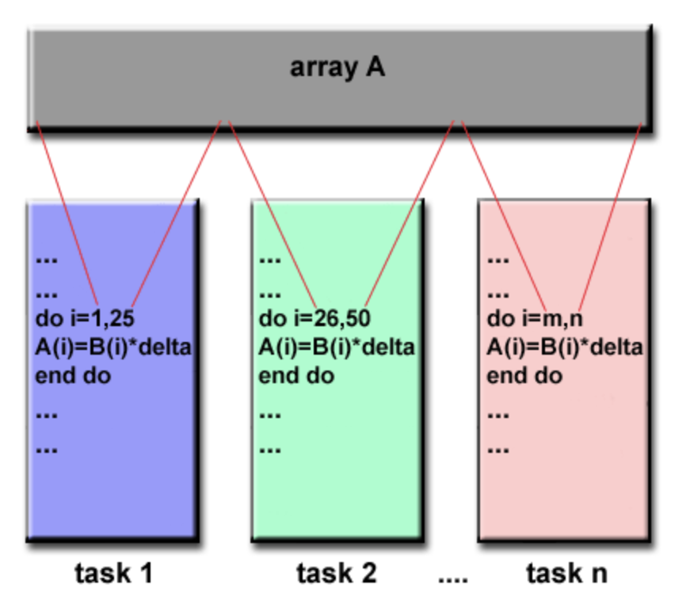
Data parallel model (PGAS)
Partitioned Global Address Space (PGAS) involves a shared data structure segmentation by task.
Each task typically performs the same operation on a different data segment.
Data structure can be shared memory or distributed memory.
The programmer specifies data distribution and alignment.
Images from the Lawrence Livermore National Laboratory Computing: https://computing.llnl.gov/
Notes:
Data parallel / Partitioned Global Address Space (PGAS) model - in this model, many task operate on the same data structure, but each task operates on a separate section of the data. The data structure itself can be either on shared memory or in a distributed memory (global address space), but is distributed between the local memory portions of each task. In this model, the programmer has to specify and distribution and alignment of the data. All tasks usually perform the same operation on a different data segment. On distributed Memory architectures, the data can be split logically and/or physically across tasks.

Slide 31
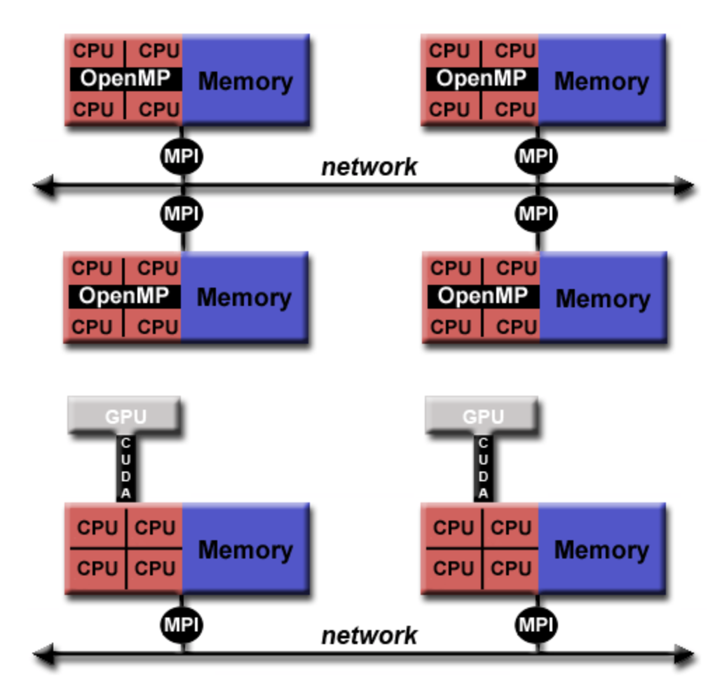
Hybrid model
Combines several of the previously described models.
The most popular models:
MPI-OpenMP:
OpenMP threads are used within each node for shared memory.
MPI processes are used for communication between nodes.
CPU-GPU with MPI: the Graphic Processing Unit (GPU) is combined with CPUs and MPI processes run on CPUs to communicate over the network.
Images from the Lawrence Livermore National Laboratory Computing: https://computing.llnl.gov/
Notes:
Hybrid Model - combines one or more of the previously described models. The two most popular once are:MPI-OpenMP: a common example of a hybrid model is the combination of a message passing model (MPI) with the threads model (OpenMP).
OpenMP threads use an on-node shared-memory model, which are computationally intensive.
MPI processes communicate between multiple nodes over the network.
CPU-GPU with MPI: the Graphic Processing Unit (GPU) is combined with CPUs and MPI processes run on CPUs to communicate over the network.
Computationally intensive kernels are off-loaded to GPUs internal to the node.
GPUs use CUDA for data exchanges on the node memory.

Slide 32
Evaluating advanced performance metrics

Slide 33
Performance evaluation
Software may perform differently depending on many factors (libraries, compilers, hardware, network etc.).
Benchmarking your code against different components is good HPC practice.
Popular performance metrics:
Speedup
Efficiency
Scaling
Notes:
Because parallel programs depend on many hardware and software components, it is often the case that they do not perform the same on different machines/architectures/OS. It is a good practice to benchmark your code against the various computer hardware and software components you are planning to work with.
There’s a need for performance metrics and software tools to evaluate the performance and decide its use is convenient or not. Since the focus of parallel computing is to solve large problems in a relatively short time, there are several factors that may contribute to this evaluation:
The type of hardware used
The degree of parallelism of the problem
Which parallel model is being used.
The performance is achieved by analyzing and quantifying the number of threads and/or the number of processes used and comparing the parallel algorithm with the sequential algorithm. Here, we introduce a few possible performance metrics: speedup, efficiency and scaling.

Slide 34
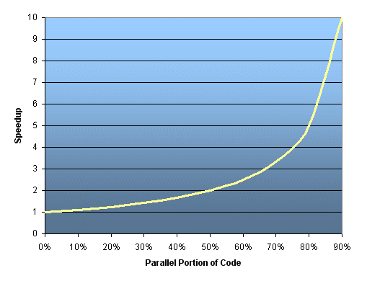
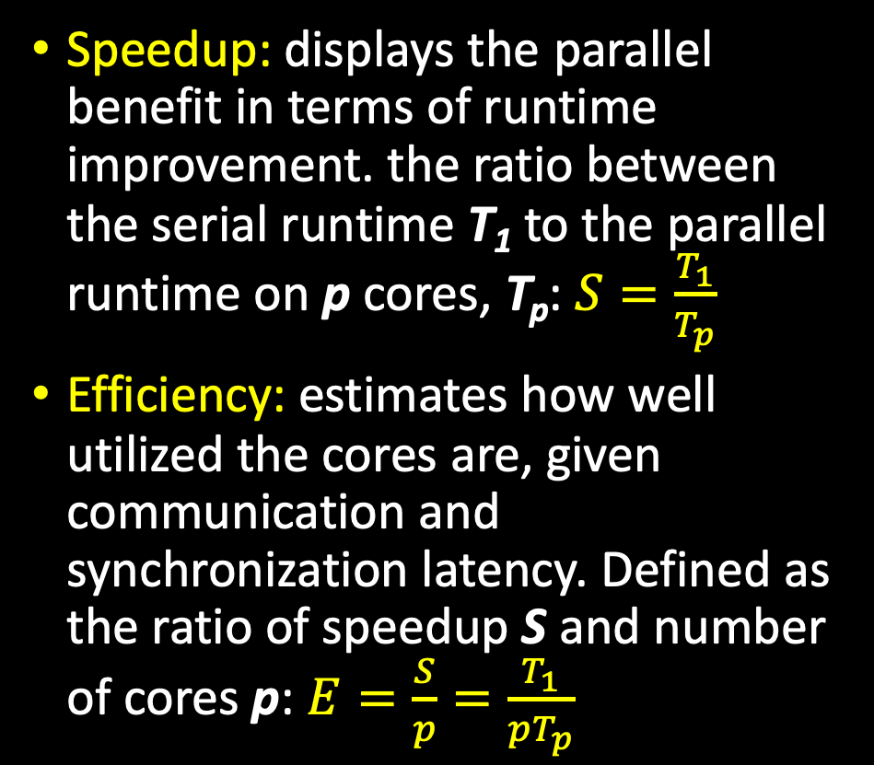
Performance metrics
Speedup: displays the parallel benefit in terms of runtime improvement. the ratio between the serial runtime T₁ to the parallel runtime on p cores, T_{p}: $S=\frac{T_{1}}{T_{p}}$
Efficiency: estimates how well utilized the cores are, given communication and synchronization latency. Defined as the ratio of speedup S and number of cores p: $E=\frac{S}{p}=\frac{T_{1}}{pT_{p}}$
Images from the Lawrence Livermore National Laboratory Computing: https://computing.llnl.gov/
Notes:
Speedup - a measure that displays the benefit of solving a problem in parallel. Speedup 𝑆S is defined as the ratio between the time it takes to run a problem in serial 𝑇1 (or on a single processing element) to the time required to solve the identical problem on p identical processing elements, 𝑇𝑝:
𝑆=𝑇1/𝑇𝑝
When 𝑆=𝑝 the speedup is considered linear. 𝑆<𝑝S<p is real speedup and 𝑆>𝑝S>p is super-linear speedup.
Efficiency - is a measure that estimates how well utilized the processing elements are at solving a task, compared to how much effort is wasted on communication and synchronization. Efficiency 𝐸 is defined as the ratio of the speedup S by the number of processing elements 𝑝:
𝐸=𝑆/𝑝=𝑇1/𝑝∗𝑇𝑝
When the speedup is linear, the efficiency becomes 1, otherwise E<1. E<<1 means that the program does not parallelize well.

Slide 35
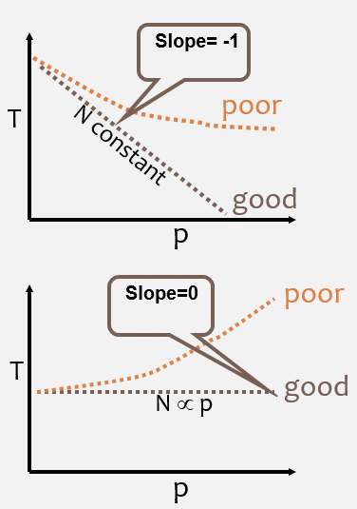
Performance metrics
Scaling: the ability to be efficient in a parallel system.
Strong scaling:
Total problem size is constant
number of cores increases
Suitable for trying to find the fastest setup for the same problem.
Weak scaling:
The total problem size is proportional to the number of cores.
Strong scaling
Weak scaling
Images from the Lawrence Livermore National Laboratory Computing: https://computing.llnl.gov/
Notes:
Scaling - is defined as the ability to be efficient on a parallel machine/environment. It identifies the computing power/speed of execution in proportion with the number of processing elements.
Strong Scaling - the total problem size stays fixed while the number of processing elements increases. This approach is good when trying to run the same problem faster. Perfect scaling would be when the problem is solved in 1/𝑝 time of the serial run.
Weak Scaling - the problem size per processing element stays fixed as the number of processing elements increases. The total problem size is proportional to the number of processing elements. This approach can give more general information about parallel applications by testing if larger problems can be solved in proportional times.
Note: The scalability of a parallel program is a result of multiple interrelated factors. It is often the case that simply adding multiple processors does not improve scalability. In this case, one needs to investigate the inherent limits and bottlenecks of the software. It may be I/O-bound, memory-bound, network-bound, processor speed-bound or may contain multiple non-parallelizable segments.

Slide 36
Exercise 3 Evaluating advanced performance metrics

Slide 37
Exercise 3 Evaluating advanced performance metrics
Goals:
Calculate the speedup and efficiency of the parallel programs multVec and calcMatrix.py.
Evaluate how each parallel program scales under weak and strong scaling conditions.
Motivation:
Learn to achieve optimal performance.
Learn about your code’s limitations (such as bottlenecks, serial parts).
Learn to precisely estimate your resource needs on HPC through performance analysis.
Notes:
OpenMP - stands for Open Multi-Processing and the industry standard for threading. It is used in many of the hardware and software vendors, organizations and individuals. It is compiler directive based, portable, multi-platform OS. Available in C/C++ and Fortran implementations and very easy to use. OpenMP principles:
Uses the fork-join method for parallel execution - all programs being with a single master thread that runs in serial until the parallel regions are reached. The master then "forks" parallel threads within the parallel region and "joins" the threads after they are all complete to execute their part.
Most data within the parallel region is shared, unless specified otherwise by the programmer.
OpenMP has no I/O specifications so be careful when reading/writing to the same file.
Exercise description:
In this exercise, we will run a C++ code with OpenMP parallelization. The motivation to use OpenMP in HPC applications is that it is often the preferred method to parallelization on a single node. OpenMP is generally limited to a single node, but is highly efficient when combined with MPI (discussed later) to allow for full scalability on the cluster.

Slide 38
Exercise 3 Tasks 1,2: Speedup & Efficiency
Open the Jupyter Notebook file: speedup_efficiency.ipynb You can open the file using the OOD Jupyter notebook app: https://ood.discovery.neu.edu/pun/sys/dashboard/batch_connect/sys/jupyter/session_contexts/new
Follow the instructions in speedup_efficiency.ipynb to produce the speedup and efficiency plots for the multVec program.
Repeat the same steps for the second program calcMatrix.py.
Compare the resulting plots - which program has the highest speedup? Which is more efficient? Does the communication model play a role?

Slide 39
Exercise 3 Tasks 3: Evaluate scaling (optional)
Strong scaling – based on the previous exercises, does any of the programs exhibit good strong scaling? Which one?
Open the Jupyter Notebook file: weak_scaling.ipynb You can open the file using the OOD Jupyter notebook app: https://ood.discovery.neu.edu/pun/sys/dashboard/batch_connect/sys/jupyter/session_contexts/new
Follow the instructions in scaling.ipynb to produce the speedup and efficiency plots for the multVec program.
Repeat the same steps for the second program calcMatrix.py.
Compare the resulting plots - which program has the highest speedup? Which is more efficient? Does the communication model play a role?

Slide 40
Thank you for your participation in this RC tutorial! Visit our website: https://rc.northeastern.edu/ Enjoy your computing!

Slide 41
Supplemental Material

Slide 42
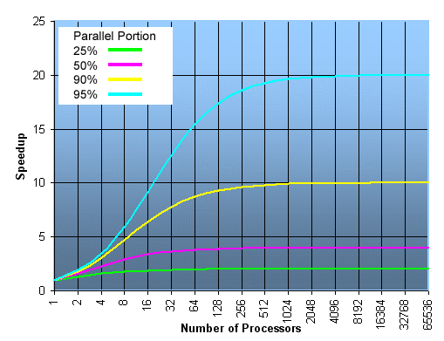

Amdahl’s Law
The maximum speedup that can be achieved is limited by the serial (non-parallel) components:
$$S_{max}=\frac{1}{1−p}$$
1-p denotes the serial component.
Assumes a fixed problem size.
Assumes the overall workload of the program is constant.
Images from the Lawrence Livermore National Laboratory Computing: https://computing.llnl.gov/
Notes:
Amdahl’s insights are often used when designing processors and parallel algorithms. It states that the maximum speedup that can be achieved is limited by the serial(non-parallelizable) components
Where 1−𝑝 denotes the serial component of a program. For example, in a program that has 80% of the code in parallel, the rest 20% is serial. Then the maximum achievable speedup is: 𝑆=1/0.2=8. Meaning that even for an infinite number of processing elements, the parallel program would run 8 times faster than the serial program.
Amdahl’s law assumes a fixed-problem size and assumes that the overall workload of a program does not change with respect to the machine size (# of processors).

Slide 43

Gustafson’s Law:
Addresses the deficiency in Amdahl’s Law and considers the number of resources involved.
The speedup S_{max}, gained by using N cores for a task with serial fraction s (non-parallel part) is:
$$S_{max}=N+\left(1−N\right)s$$
This law redefines efficiency, as the serial part limitations may be countered by increasing increasing the total amount of computation.
Images from the Lawrence Livermore National Laboratory Computing: https://computing.llnl.gov/
Notes:
Gustafson’s Law addresses the deficiency of Amdahl’s law, which does not consider the number of computing resources involved in solving a task. It suggests that the best way to solve the execution time of a parallel problem is to consider all the computing resources, and on the basis of this information it fixes the problem.

Slide 44
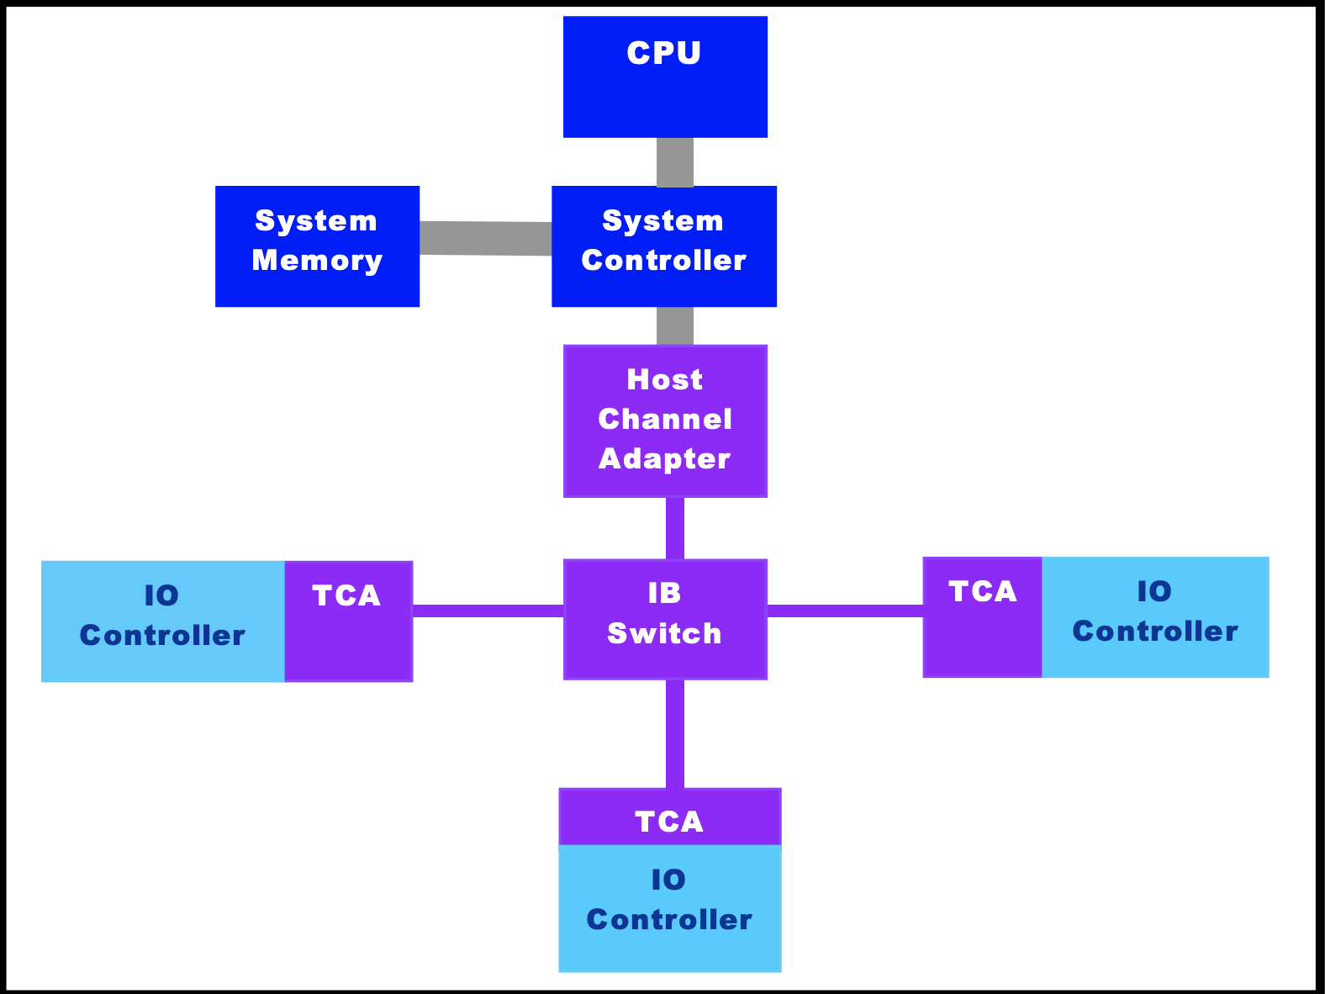
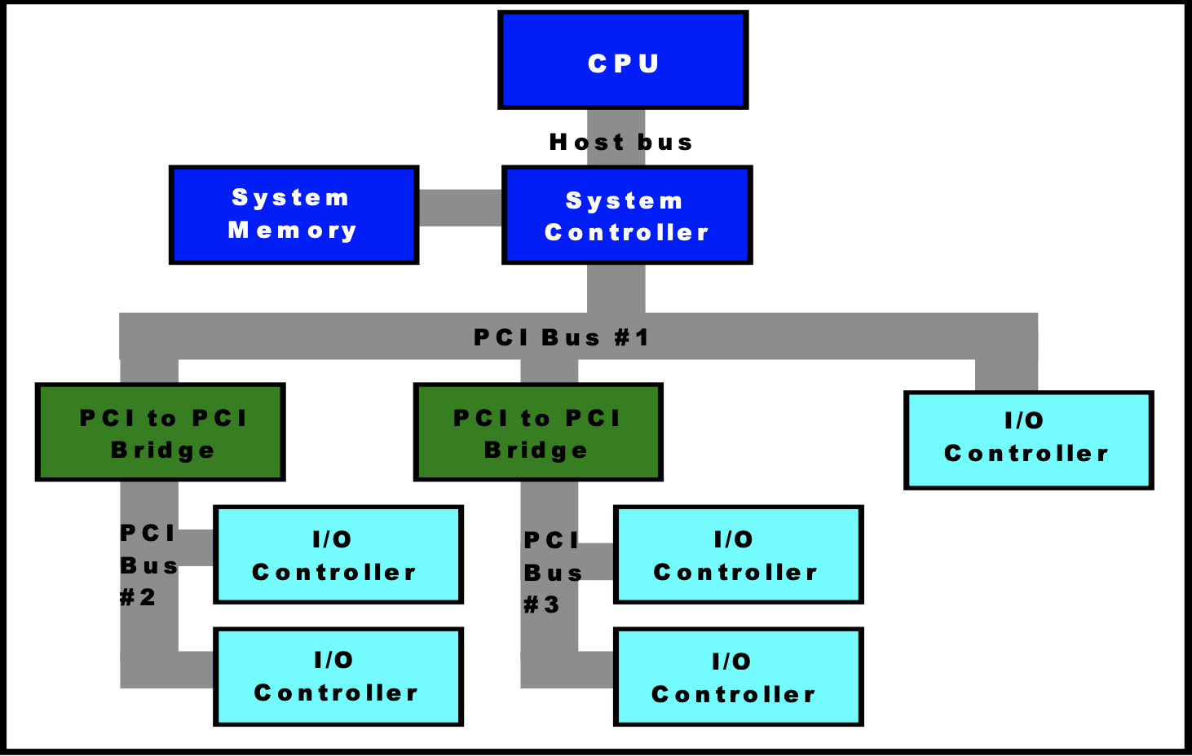
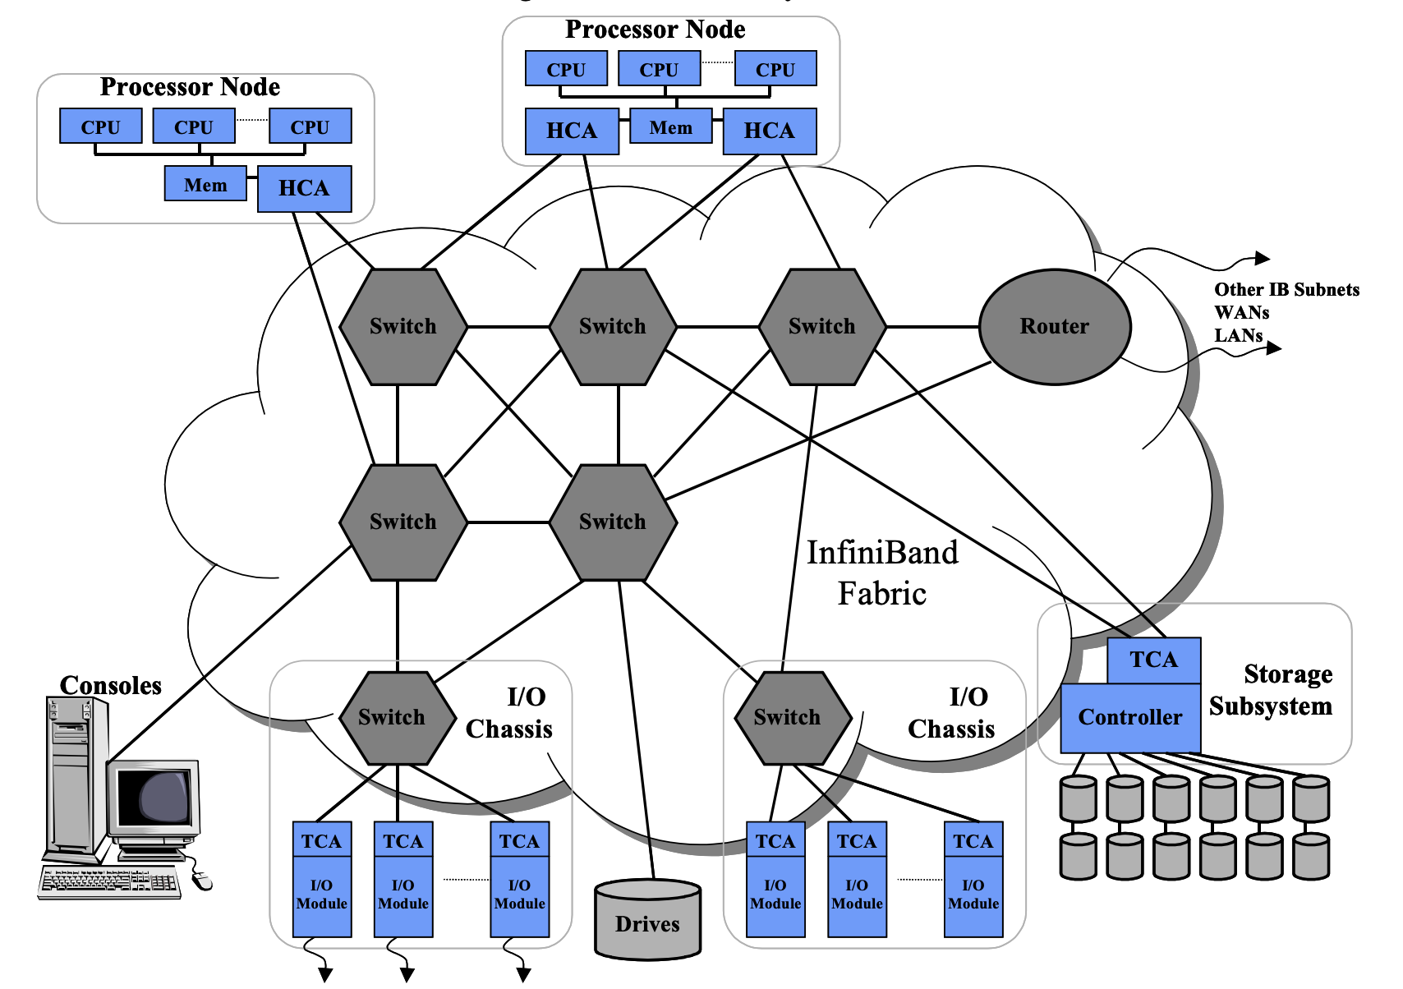
Increase MPI performance with InfiniBand
Discovery offers the InfiniBand 100HDR inter-node network that outperforms the regular ethernet 10Gb/s speed, with speeds up to 100Gb/s.
Conventional shared-bus architecture:
All communication shares the same bandwidth.
Latency and congestion increases with each bridge added to the system.
Uses Ethernet for server-server communication.
Switched fabric architecture:
Designed for fault tolerance and scalability.
Unlike a shared bus architecture, the aggregate bandwidth of a system increases as additional switches are added to the network.
Notes:
Images taken from Mellanox Technologies: https://www.mellanox.com/pdf/whitepapers/IB_Intro_WP_190.pdf

Slide 45
Run InfiniBand-supported MPI on Discovery
Please note that only the newer d-nodes (Intel Skylake microarchitecture) have InfiniBand network.
To allocate d-nodes, use the following SLURM flag: --constraint=ib
Only MPI programs can use InfiniBand. Use ”module show <mpi_library_name>” to check if InfiniBand is supported. Some Discovery modules will have “skylake” in their name.
# Allocate 2 d-nodes (Skylake), each has 56 cores:
srun –p express --pty -N 2 –n 112 –t 01:00:00 –-constraint=ib /bin/bash
# First check if the module is InfiniBand-enabled: $ module show mpich/3.3.2-skylake-gcc7.3
# Load the mpich module: $ module load gcc/7.3.0 mpich/3.3.2-skylake-gcc7.3
# Compile and run your program (compilation part not shown…): $ mpirun –n 112 <my_MPI_program>

Slide 46
Enabling InfiniBand Support in Python (optional):
Since MPI is just an API, it supports multiple implementations.
Most MPI implementations (Open MPI, MPICH etc. ) support communication over the InfiniBnand network.
The mpi4py library provides a Python wrapper around your choice of MPI implementation. Please note that the default MPI library installed with mpi4py(using conda or pip install) will not support InfiniBand.
To build mpi4py with InfiniBand support, type (for example using OpenMPI):
# First check if the module is InfiniBand-enabled: $ module show mpich/3.3.2-skylake-gcc7.3
# Load the openmpi module: $ module load mpich/3.3.2-skylake-gcc7.3 # Install mpi4py using mpich:
$ pip install --user mpi4py

Slide 47
Exercise 4 – Infiniband MPI (optional)
Repeat Exercise 2 running on the InfiniBand network. Enter directory Exercise_4 and inspect the main_py.bash script:
Notice the differences in the submission script:
Added flag: #SBATCH --constraint=ib
The use of mpi4py compiled with InfiniBand-supported MPI library. Here, we also load the following libraries:
Submit the job:
Re-evaluate the performance metrics, is there an improvement compared to results from Exercise 2 and Exercise 3?
$ cat main_py.bash
$ module load gcc/7.3.0 mpich/3.3.2-skylake-gcc7.3
$ module load miniconda3/2020-11-skylake
$ sbatch main_py.bash

